Slide 1


_COMPILER DESIGN PROJECT 9_
BCSE III SEM 2
SECTION- A1
GROUP - 3

Slide 2
MEMBER DETAILS
DEBADRITA ROY 001910501025
AISIK SAHA 001910501017
ROHIT KUMAR SADHUKHAN 001910501023
ANUBHAB GHOSH 001910501024
SUJAN BISWAS 302010501003

Slide 3
PROBLEM
STATEMENT
Construct a CFG for a language consisting of only SQL DML statements, i.e., SELECT, INSERT and DELETE.
Write a lexical analyser to scan the stream of characters from a SQL query and generate a stream of tokens.
Write a top-down parser to detect syntax errors.

Slide 4
SUPPORTED FORMATS
The SELECT statement supports “where” clause with >=, =, >, <, <=, <>, AND, OR and NOT. No nesting of SELECT statements are supported. ‘ORDER BY’ and ‘GROUP BY’ clauses along with ‘HAVING’ clause are supported.
The INSERT statement supports the following formats.
INSERT INTO table_name VALUES(value1,....);
INSERT INTO table_name(column1,....) VALUES(value1,....);
The DELETE statement supports the following formats.
DELETE FROM table_name WHERE attribute_name=value;
DELETE FROM table_name;

Slide 5
CONTEXT FREE GRAMMAR
Context-free grammars are defined by rules of the form A → γ ,where A is a nonterminal and γ a string of terminals and nonterminals.
Context-free languages are the theoretical basis for the syntax of most programming languages
It supports nested constructions.

Slide 6
PART I: CFG FOR THE GIVEN LANGUAGE
Q -> S ; | I ; | D ;
S -> SL ATT FK TNAME WH GB OB
SL -> sel_keyword
ATT -> * | A X RES
A -> id | AGG_OPER
RES -> epsilon | , A X RES
X -> epsilon | as_keyword id
AGG_OPER -> fn_name ( T )
T -> * | id
FK -> from_keyword
TNAME -> id RES'
RES' -> epsilon | , id RES'
WH -> epsilon | where_keyword PRED
PRED -> PRED' MORE | not_keyword PRED | ( PRED )
MORE -> epsilon | bin_log_op PRED
PRED' -> id rel_op RHS
RHS -> id | int_const | str_const
GB -> epsilon | group_keyword by_keyword id RES' RES''
RES'' -> epsilon | having_keyword HPRED
HPRED -> not_keyword AGG_OPER rel_op int_const RES'''
| AGG_OPER rel_op int_const RES'''
RES''' -> epsilon | bin_log_op HPRED
OB -> epsilon | order_keyword by_keyword ATTR_NAMEORDER RES''''
ATTR_NAMEORDER -> id ORDERING
ORDERING -> epsilon | asc_keyword | desc_keyword
RES'''' -> epsilon | , ATTR_NAMEORDER RES''''
I -> insert_keyword into_keyword id COLVAL
COLVAL -> ( id TI CONST ) | values_keyword ( CONST RES''''' )
RES''''' -> epsilon |, CONST RES'''''
TI -> , id TI CONST , | ) values_keyword
CONST -> int_const | str_const
D -> DL FK DTNAME WH
DL -> del_keyword
DTNAME -> id

Slide 7
DFA
DFA refers to deterministic finite automata. Deterministic refers to the uniqueness of the computation. The finite automata are called deterministic finite automata if the machine is read an input string one symbol at a time.
In DFA, there is only one path for specific input from the current state to the next state.
DFA does not accept the null move, i.e., the DFA cannot change state without any input character.
DFA can contain multiple final states. It is used in Lexical Analysis in Compiler.

Slide 8
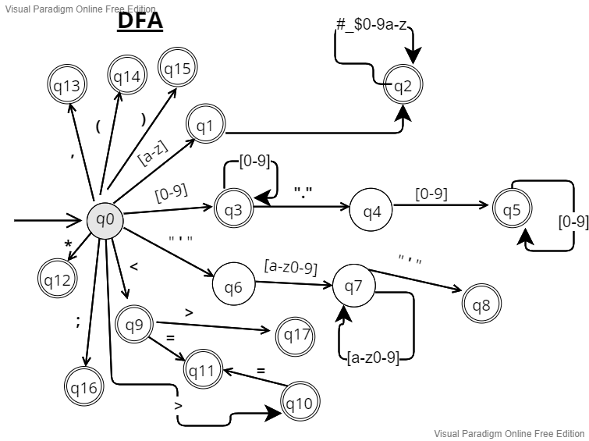
PART II : LEXICAL ANALYZER TO SCAN STREAM OF CHARACTERS

Slide 9
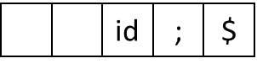
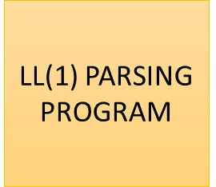
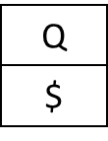

PART III : TOP-DOWN PARSER TO DETECT SYNTAX ERRORS
INPUT
STACK
LEFTMOST DERIVATION

Slide 10
CONSTRUCTION OF PARSING TABLE
Step 1: Compute First and Follow sets
First set :
First set for any symbol in the grammar contains the
terminal symbols which can be found at the beginning of
any string which can be generated from the symbol.
Follow set :
Follow(A), for non-terminal A, is the set of all terminals a
that can appear immediately to the right of A in some
setential form.

Slide 11
CONSTRUCTION OF PARSING TABLE
STEP 2 :
For each production A → α of the grammar, do the following steps -
A) For each terminal a in FIRST (α), add A-→ α to M [ A, a ]
B) If ɛ is in FIRST (α), add A-→ α to M [ A, b ] for each terminal b in FOLLOW (A)
C) If ɛ is in FIRST (α) and $ is in FOLLOW (A), add A-→ α to M [ A, $]
STEP 3 :
Given the non-terminal A on top of the stack and an input token that is not in FIRST(A) (or in FOLLOW(A) if ɛ is in FIRST(A)), there are the following three alternatives:
Pop A from the stack [if current input token is $ or is in FOLLOW(A)] – pop
Successively pop tokens from the input until a token is seen for which we restart the parse [if the current token is not $ and is not in FIRST(A) U FOLLOW(A)] – scan

Slide 12
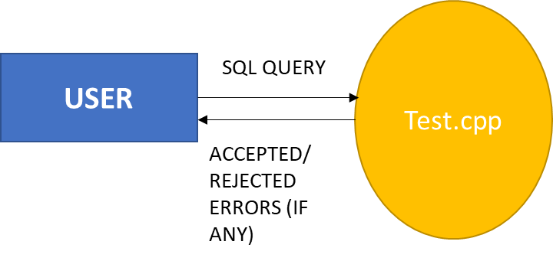

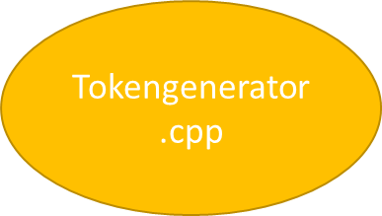
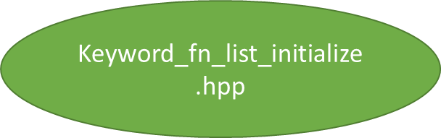
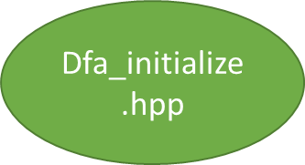

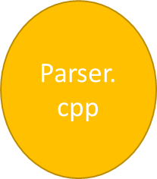

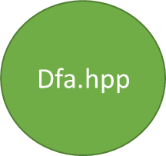

PROJECT OUTLINE

Slide 13
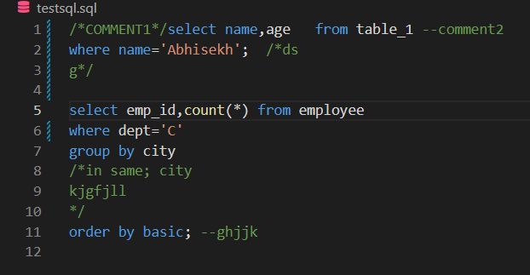
INPUT AND OUTPUT SCREENSHOTS
INPUT FILE

Slide 14
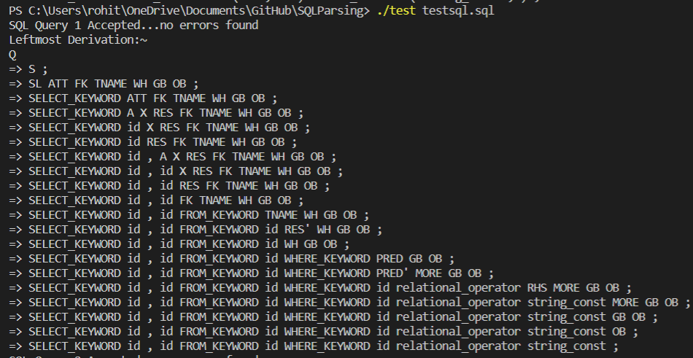
INPUT AND OUTPUT SCREENSHOTS

Slide 15
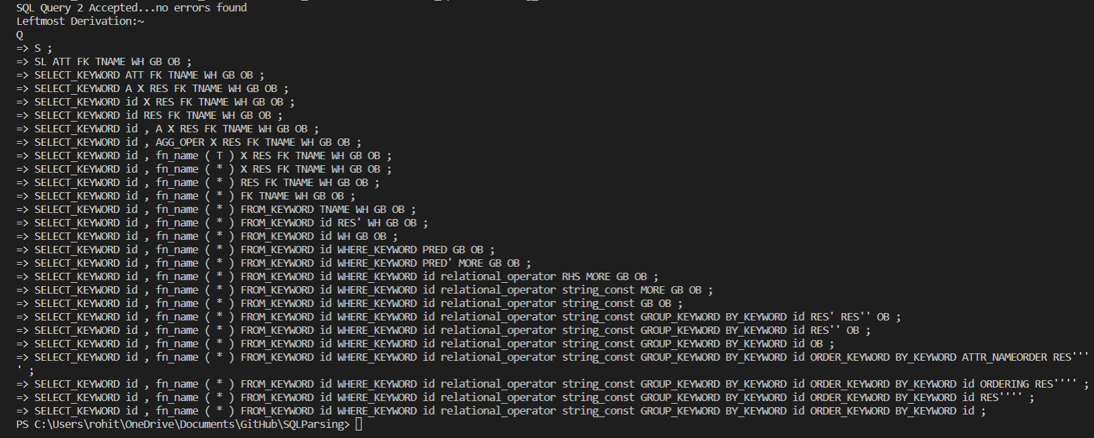
INPUT AND OUTPUT SCREENSHOTS

Slide 16
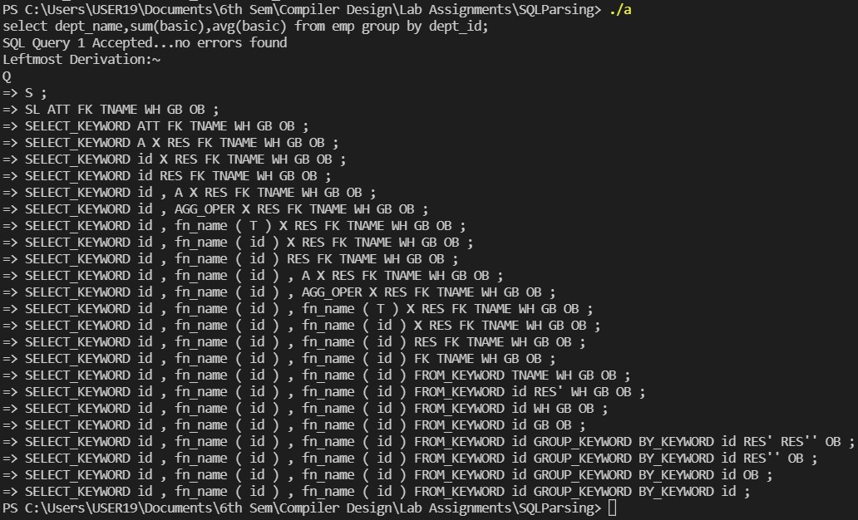
INPUT AND OUTPUT SCREENSHOTS

Slide 17
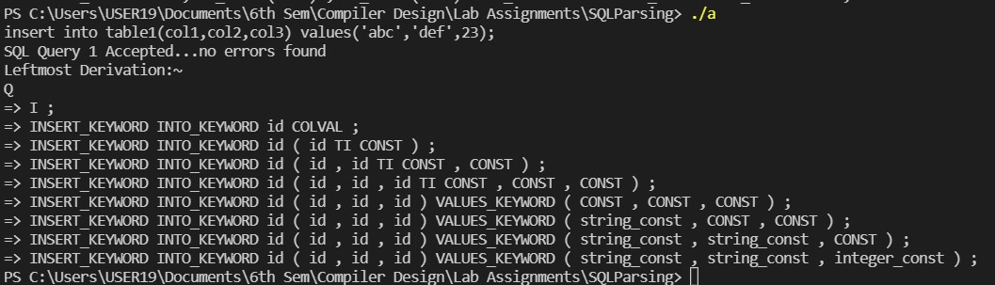
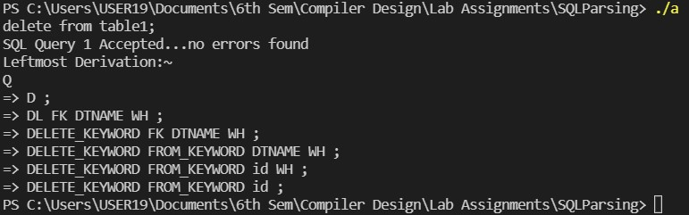
INPUT AND OUTPUT SCREENSHOTS

Slide 18
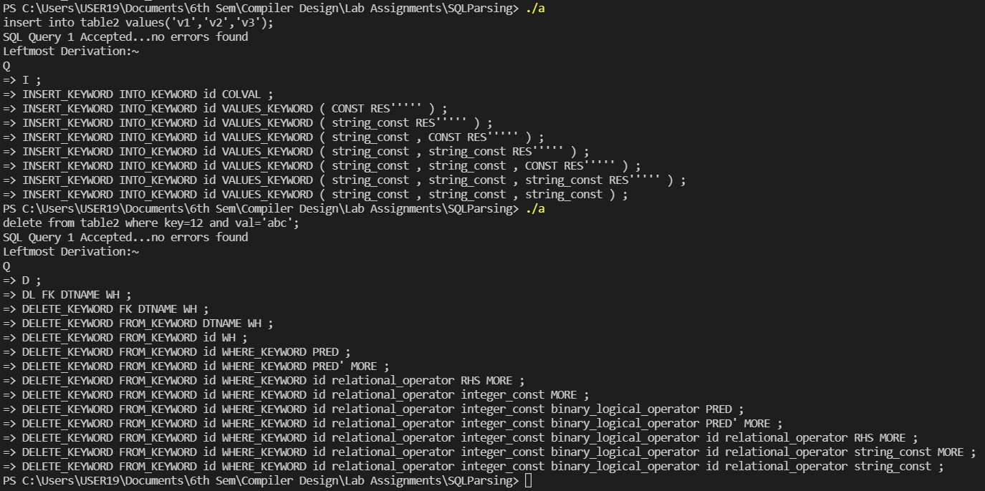
INPUT AND OUTPUT SCREENSHOTS

Slide 19
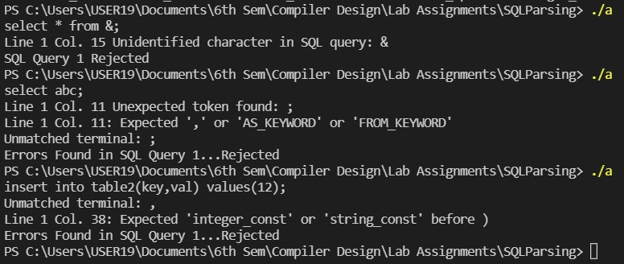
INPUT AND OUTPUT SCREENSHOTS

Slide 20
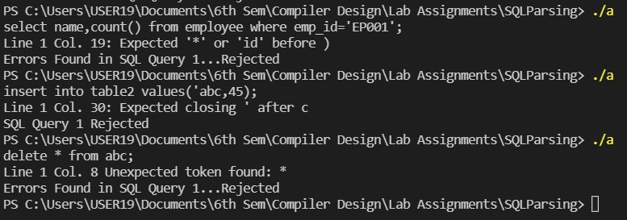
INPUT AND OUTPUT SCREENSHOTS

Slide 21


